Slide 1

Student details
Name
Skills Build Email ID
College name
College state
Internship domain and internship start and end date
: SAI SATYAM BAGADI
: saisatyambagadi@gmail.com
: Jawaharlal nehru technological university
gurajada vizianagaram
: Andhra Pradesh
: 05/06/2023 to 23/07/2023

Slide 2

Problem statement
The project name is employees Burnout analysis as a part of this project we have to use given data set to train the machine learning model so that the model can be able to find the burnout values of the new employees.
We can use any type of ML algorithms which gives a good accuracy
But before traing the model We have to apply some pre-processing steps on the data set so that ml algorithms can be trained with good quality and accuracy

Slide 3


Agenda
Project overview
Who are the End users
my solution and its value proportion
how did I customise the project and make it my own
Modelling
Results
links

Slide 4

Project overview
Coming to the overview of this project we have to train the mission learning model which can able to predict the Burnout value of the employees this is our aim for that we are using a data set to train the mission learning model
But before using the data set for training we have to pre-process the data set that is we have to remove the noise and unnecessary attributes from the data set to make it more accurate and reliable
Now by analysing the data set we have to choose the correct algorithms for the training and among those multiple algorithms we have to select the one which gives high accuracy

Slide 5

Who are the end users ?
The company managers and HR’s are going to be the end users of this project because they have to monitor the situation or state of the employee that is weather he is okay are feeling any stress due to workload and according to that Tasks will be allotted to the Employees.
Sometimes employees can also check their stress levels so they also can be the end users

Slide 6

my solution and its value proportion
I solve this problem by using ridge regression technique in fact I used many ML algorithms but among all of them this ridge regression gives me the best accuracy so I choose the ridge regression
By using this model I got an accuracy nearly 83% so the model can identify the burnout values of new employees with high accuracy
So the end users simply give the attributes of the new employees to the model then it gives a value based on that attributes which is the burnout value of the employee.

Slide 7
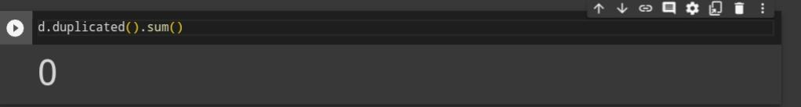
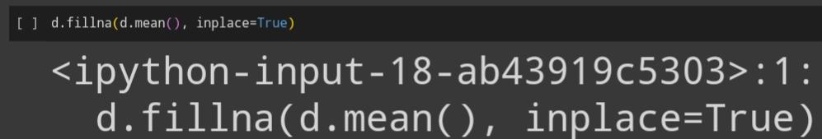
how did I customise the project and make it my own
I have done 2 major customisations in this project
1.Pre-processing of data :
removing the duplicate rows In the dataset (if present)
Filling the null values with mean value of the attributes

Slide 8
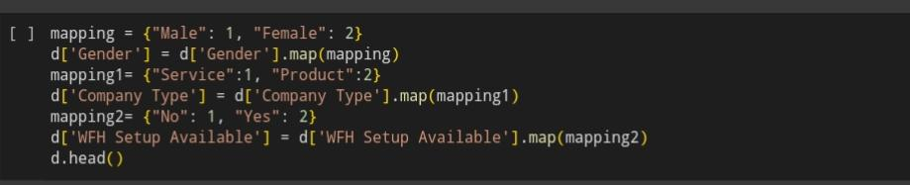

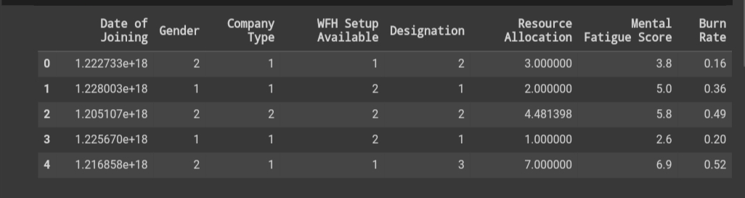
Changing the data types of the attributes

Slide 9
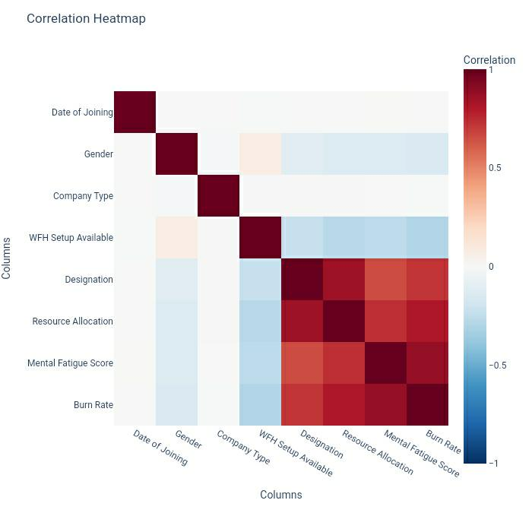
2.Removing unwanted attributes:
By observing this correlation heat map we can say that burnout value is highly correlated with designation, resource allocation, and mental fatigue score attributes remaining all attributes are less co related positively or negatively with the Burnout value so they didn’t show much affect on the burnout value so we can remove date of joing,gender, company type and WFH setup attributes.Employee ID Is just an Unique Identification but it didn’t have any relation with Burnout value so I removed it.

Slide 10
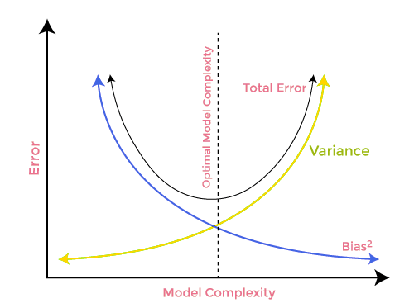
Modelling
ridge regression is a modification of the regular linear regression. It helps prevent problems when there are many input variables or when those variables are highly correlated with each other.In standard linear regression, we try to find the best fit line to predict an outcome based on multiple input variables. However, when there are too many variables or some of them are closely related, then we use ridge regression .
Ridge regression adds a penalty to the traditional regression equation, which helps to keep the coefficients (weights) of the variables in check. This prevents them from becoming too extreme and helps to create a more stable and accurate prediction model.

Slide 11
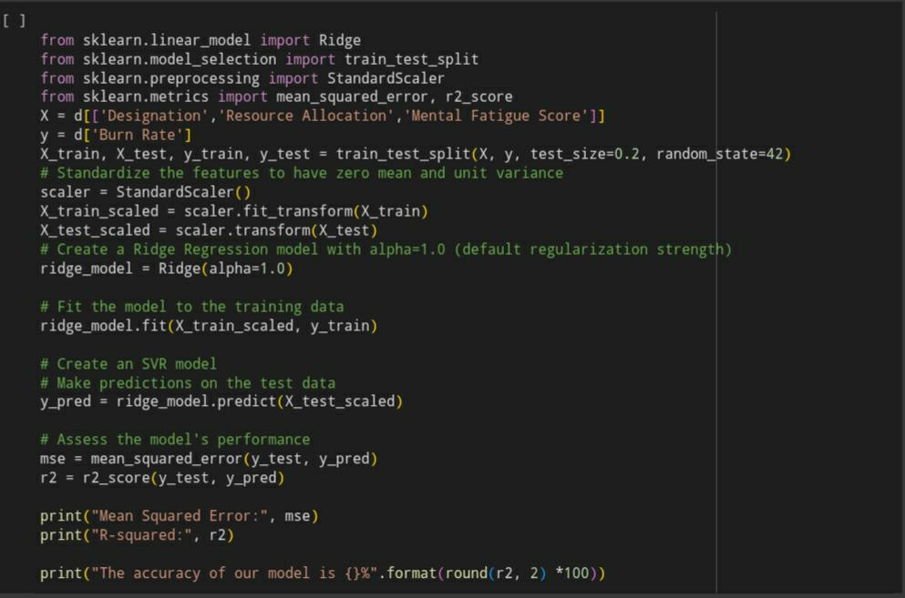

Slide 12

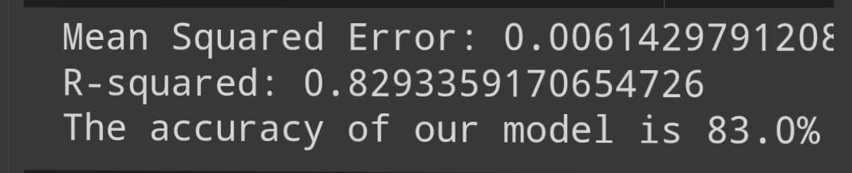
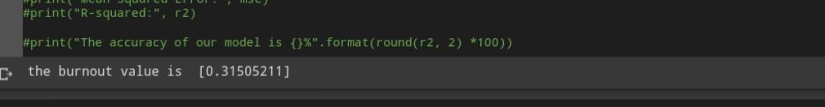
Results
As we discussed earlier the result would be the accuracy percentage and burnout value of new employees.
Accuracy of the ridge regression
Burnout values of new employees

Slide 13

Links
Project code
Ridge regression
Ridge regression guide
Ridge regression video explanation

Slide 14


